Slide 1


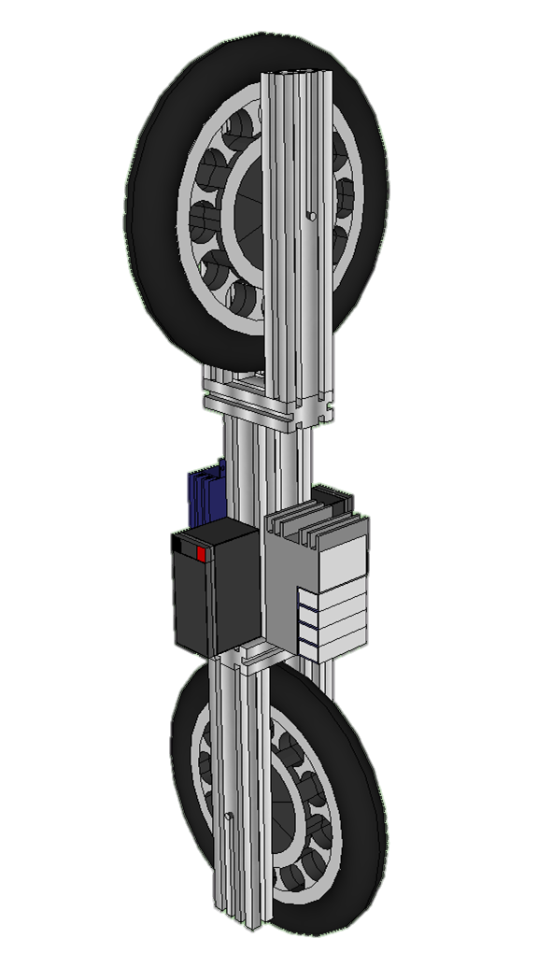
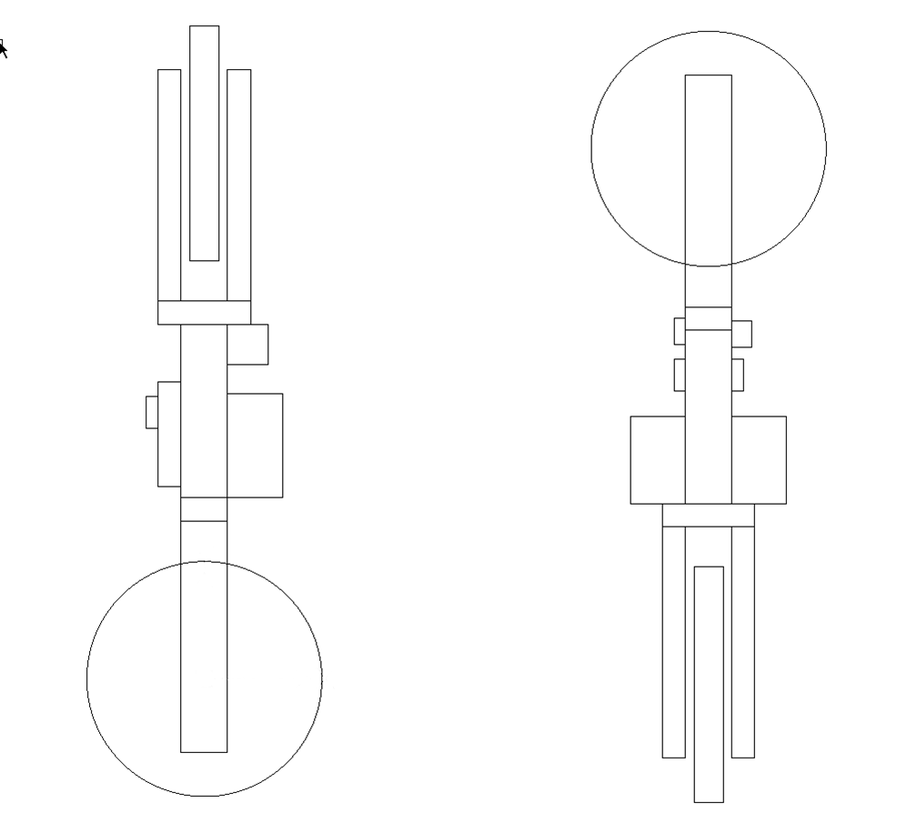
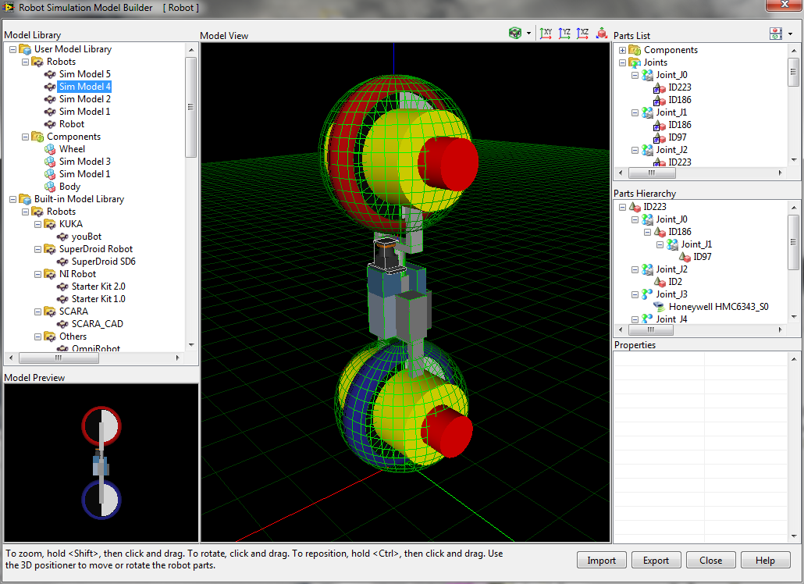
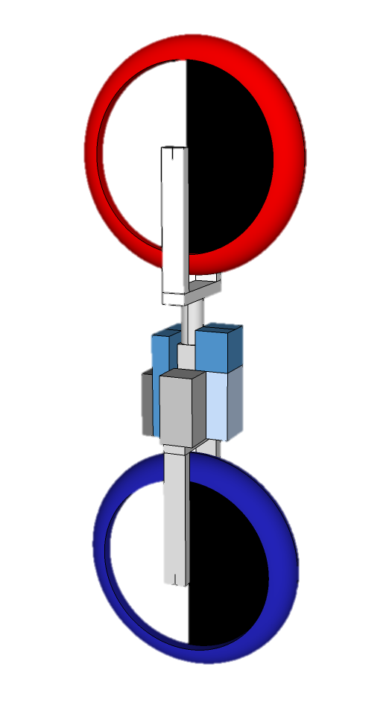
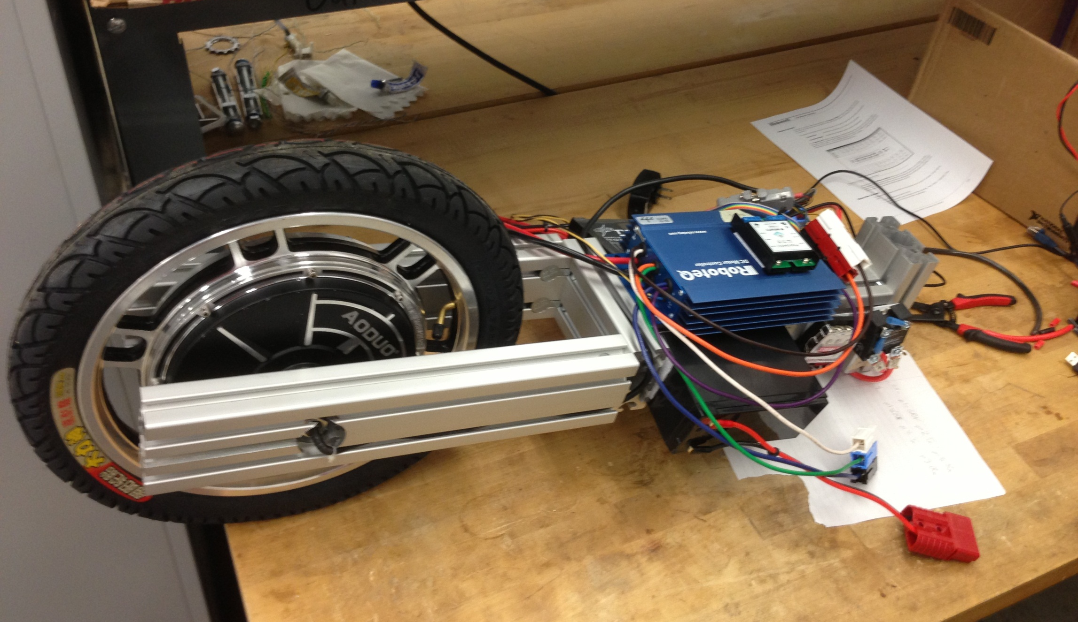
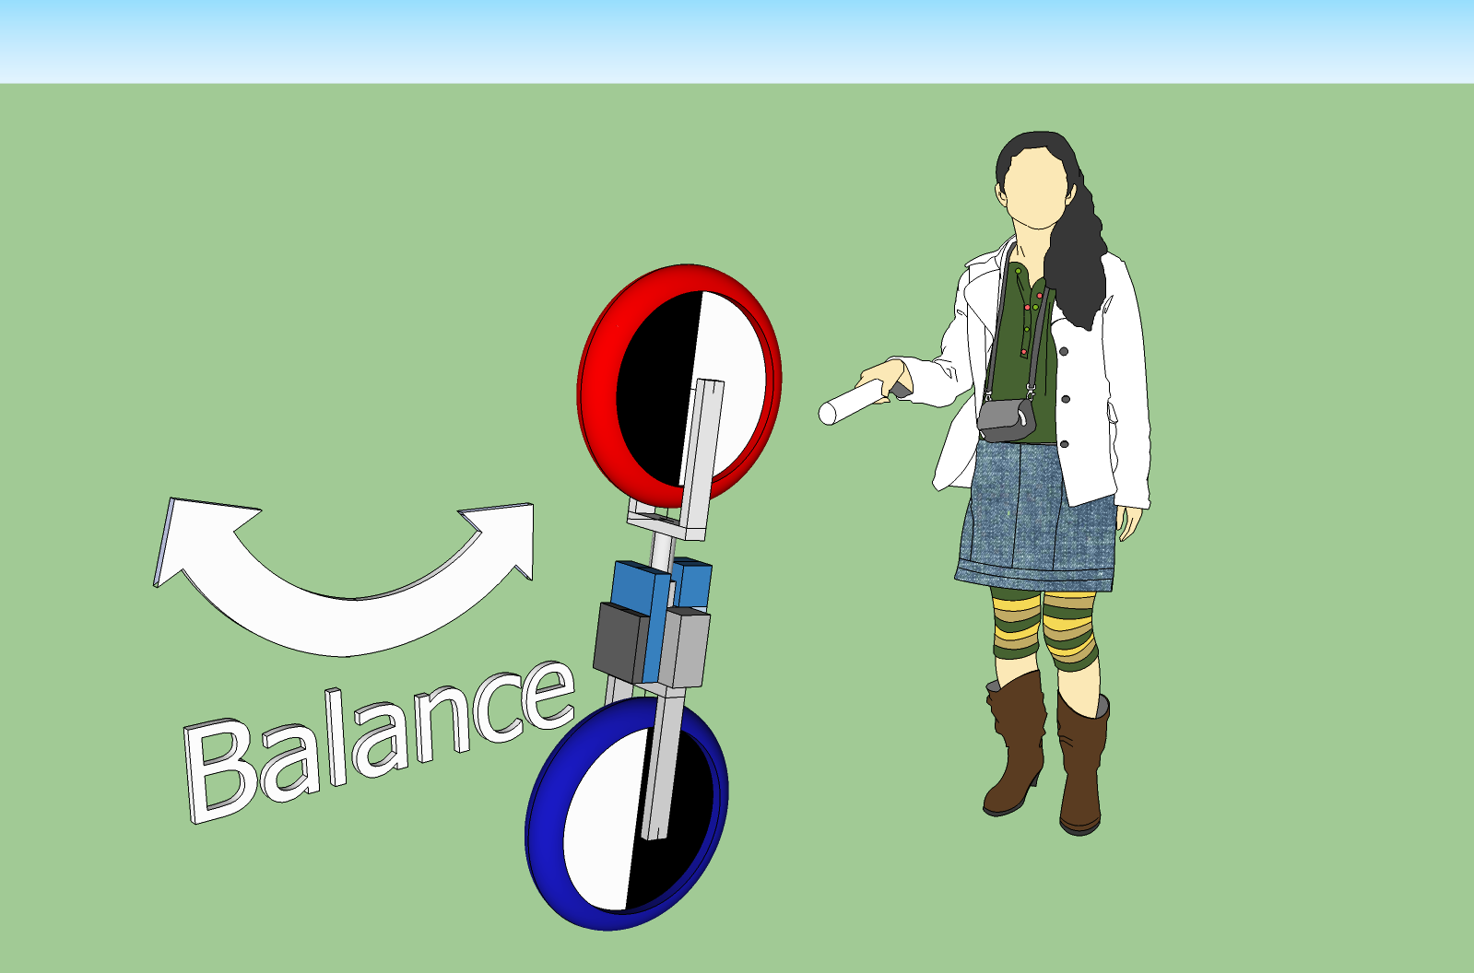
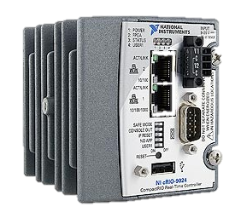
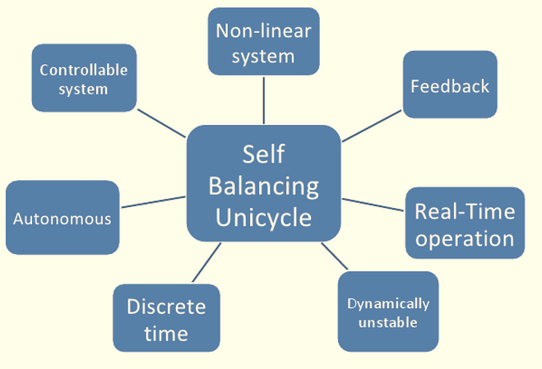
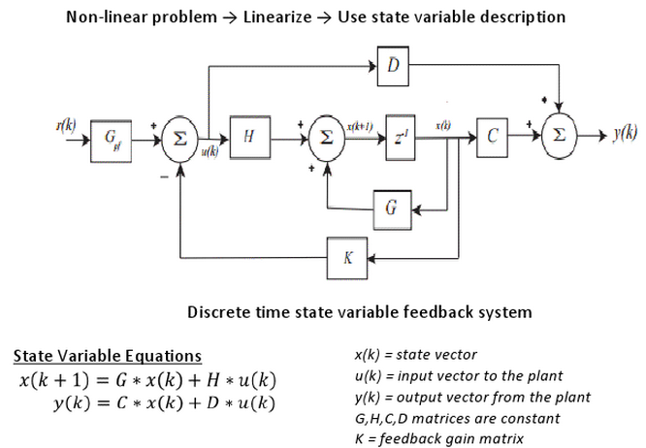
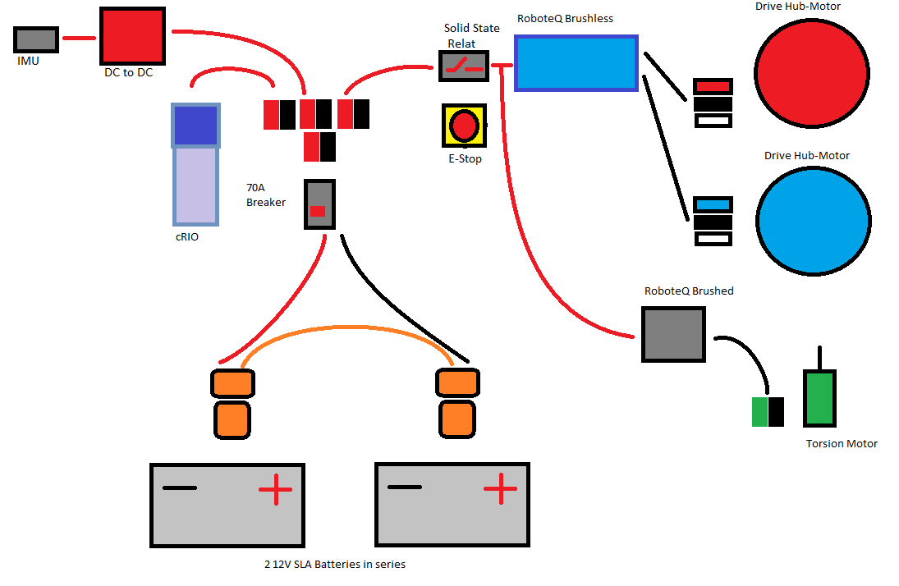
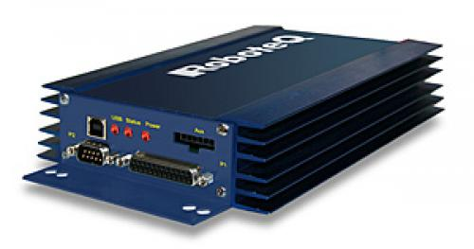
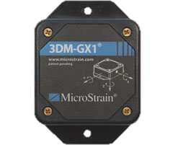
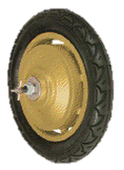
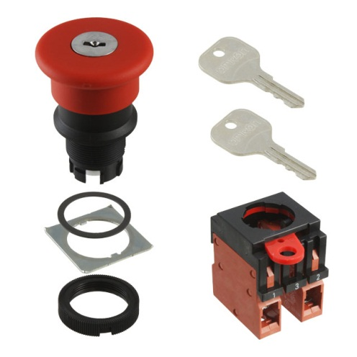
Self Balancing Unicycle Robot
Kevin Collins, Spencer Carver, Ander Solorzano, Ruffin White-Magner
Client: Andy Chang (National Instruments) Supervisor: Dr. Robert Throne
Problem Description: The goal of this project is to design and construct a robotic self-balancing unicycle for National Instruments (NI). Using NI hardware and software, such as the Compact Rio Real-Time Controller and their LabVIEW software, this project is an effort to demonstrate NI’s real-time solutions and their Robotics Tool Kit as a viable solution for advanced robotic systems and controls. In addition to the physical device, NI has also asked the team to utilize the Robotics Simulator within LabVIEW to model and program the unicycle, and ensure that the development environment is behaving appropriately. This robotic prototype is being designed to serve primarily as a demonstration for NI Week 2013, a convention held during the summer in Austin, TX where National Instruments showcases uses for their products and reveals new ones.
Mechanical Design
Unicycle Design
Simulation
X-Y Direction
α
Z-Y Direction
θ
Using the Inertial Measurement Unit (IMU) as a feedback sensor for the control system, the real-time controller calculates the direction and magnitude of the control effort necessary to maintain a balanced state. The motor controllers act upon the control effort to provide the required power to the hub motors, and also serve as a method for encoding the wheel’s position back to the real-time controller.
Using LabVIEW’s Robotic simulation toolkit, the Sketchup model is imported with its physical properties specified. Simulating all the robot’s actuators and sensors allows a development of initial control for feasible inverted stability.
τ
τ
The modeling of the unicycle was done in two distinct portions, each with specific constraints to be optimized,
and combined later on to fully define our model. The problem is most similar to that of an inverted pendulum, though this similarity is only true in the one-dimensional case, as our system can tip from side to side; a restriction normally present on inverted pendulums. Originally, the design featured a torsion motor about the central axis of the robot, which added more possibilities to the design and caused the robot’s balance to more accurately resemble a human riding a unicycle, but overly complicated the
model and was ultimately changed to the current design for simplicity.
Control System Design
System Assembly
Compact RIO used for real-time computation
RoboteQ HBL2350 dual channel 3-phase motor controller
Our control design project faces some major obstacles. We are dealing with an autonomous non-linear system that will dynamically change while it runs. The advantages of our design are that it is a controllable system that we will control
Based on the flow diagram of a basic discrete time state variable feedback system we can obtain the state variable equations. We will have to model the system’s plant, modify any initial conditions, place poles in the system, and allow the system to reach a stable balancing state.
IMU 3DM-GX3-45 as gyroscope
Emergency stop switch
in discrete time.
3-phase 12V hub motor

